Slide 1
Wildlife and Excursion Photos
Kodiak West Travel

Slide 2
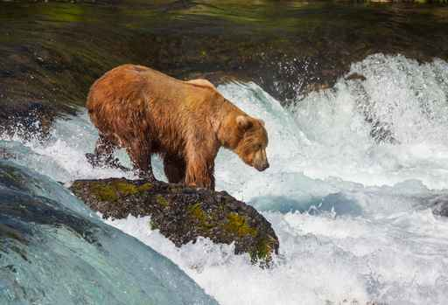
Be Careful
Use common sense
Never approach a real bear or bear cub
Your best pictures will be those in which you are not intruding on a wild animal’s home

Slide 3
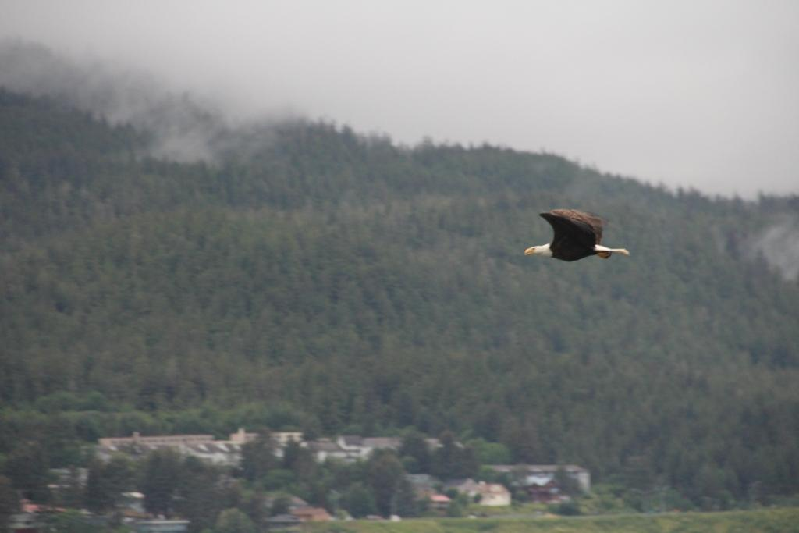
Lights, Camera, Action
Be prepared at all times with your camera. You will want to be ready if nature decides to fly right by you.

Slide 4
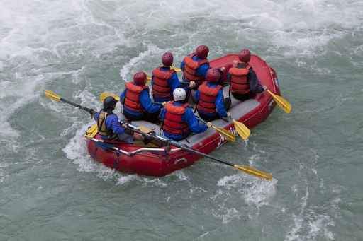
Rafting the Refuge
River rafting is a popular way to tour the refuge. Trips are scheduled from mid-June to early September and are typically planned for six to eight days.

Slide 5
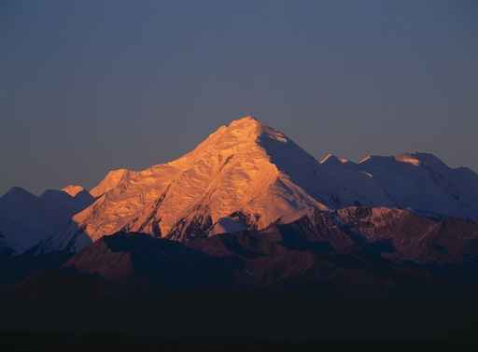
Brooks Mountain Range
A treeless range peppered with rivers and streams and home to a variety of birds and land and marine mammals.

